Slide 1
CSS Box Model

Slide 2
AGENDA
Writing Semantic HTML5
Block elements / Inline elements
Reset Normalize?
Box sizing: border-box (non-default)
CSS debugging in DevTools

Slide 3
1. Writing Semantic HTML

Slide 4
HTML Syntax

Slide 5
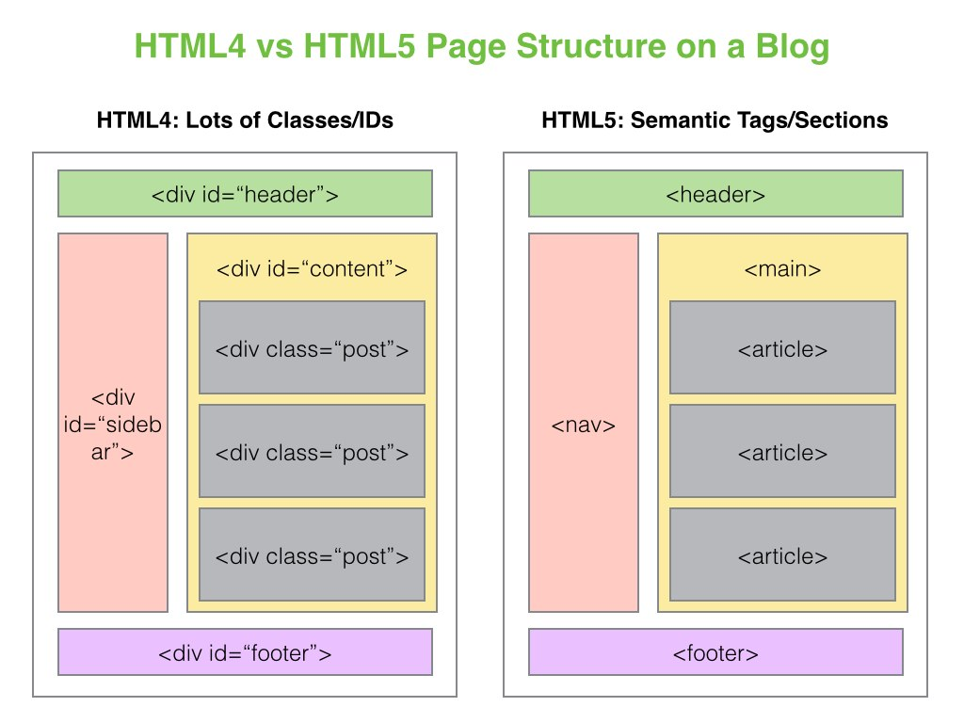
Semantic HTML5

Slide 6
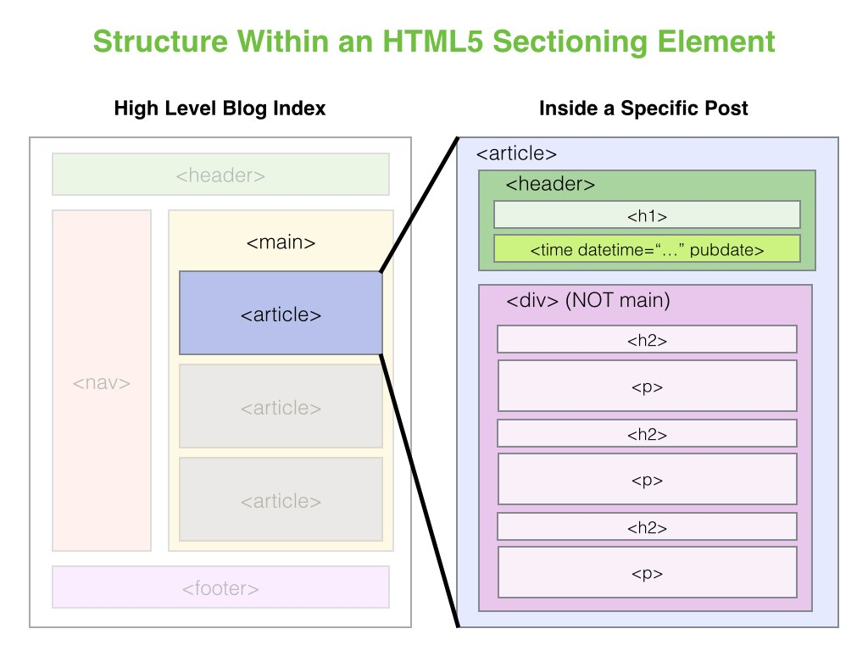
Semantic HTML

Slide 7
2. Block Level Elements / Inline Level Elements

Slide 8
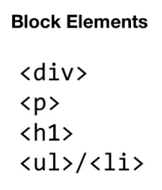
Block Level Elements

Slide 9
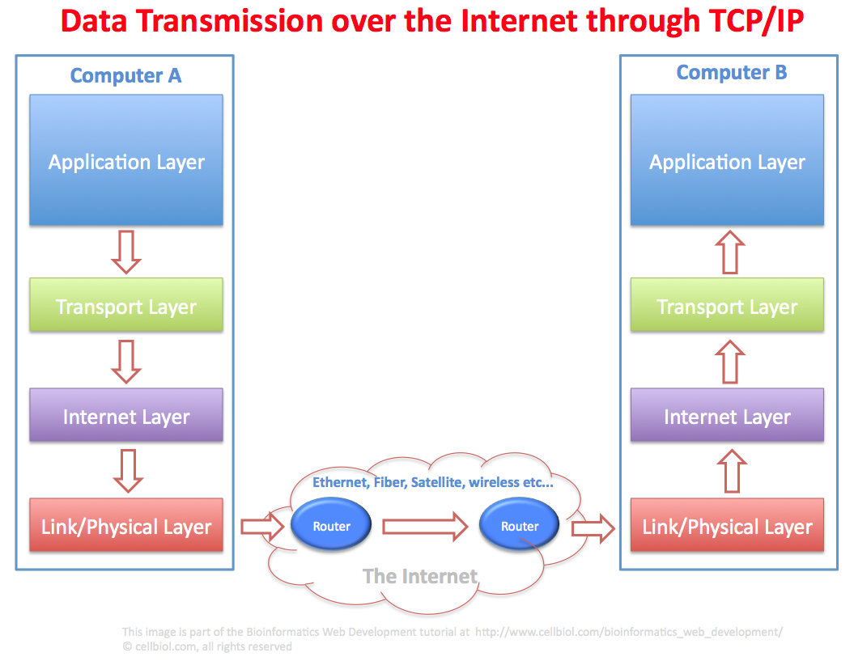
1. Web Server vs Web Client
TCP/IP suite of Protocols

Slide 10
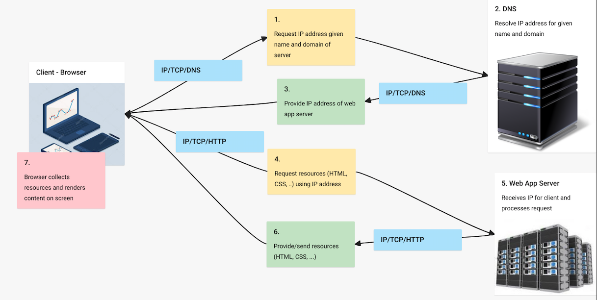
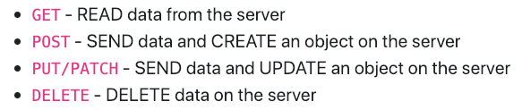

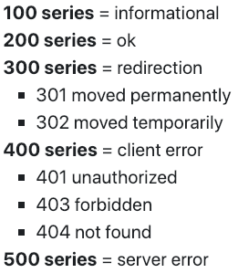
2. HTTP Fundamentals

Slide 11
2. HTTP Fundamentals
API Endpoints

